Slide 1

Security Risks
Attacks, threats, risks and their impact on security goals

Slide 2

Introduction
Security incidents undermine organizational trust, operations, and compliance. This presentation summarizes common attack types and their real-time impacts on the confidentiality, integrity, and availability (CIA) triad.
Early detection and layered controls reduce exposure and operational disruption, preserving business continuity and regulatory standing.

Slide 3
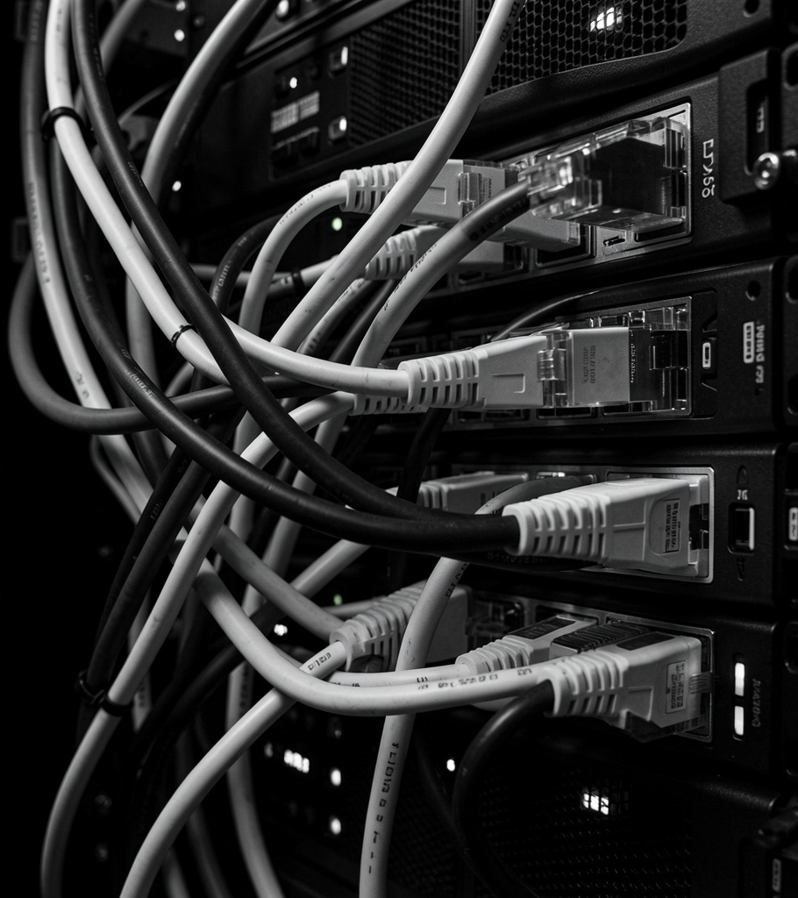
01
Attack Types

Slide 4
Malware — Ransomware encrypting hospital records (real-time)
Ransomware can encrypt patient records, halting care delivery and forcing ransom payments. Immediate effects include availability loss and emergency workarounds, while long-term consequences involve legal liability and reputational damage.
Containment, offline backups, and endpoint detection reduce impact and recovery time.

Slide 5
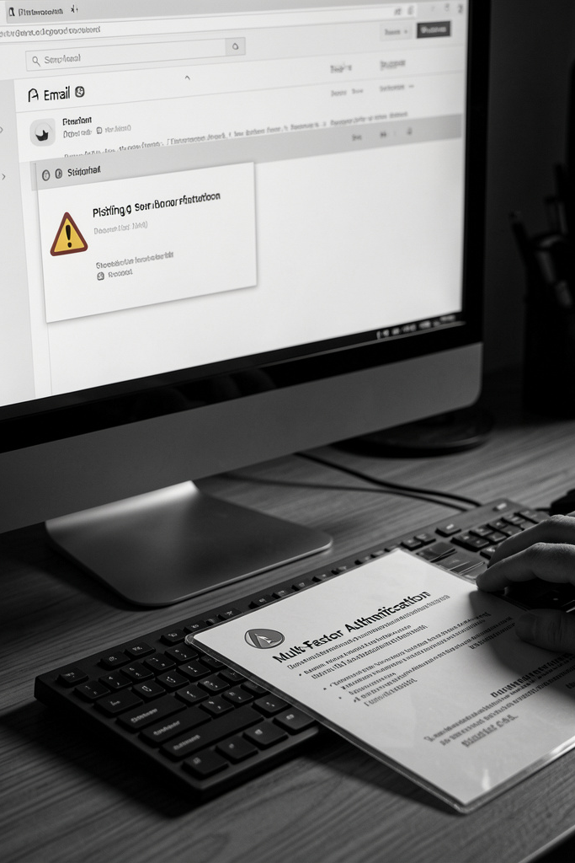
Phishing — Employee targeted email stealing credentials (real-time)
Targeted phishing yields stolen credentials, enabling lateral movement and data exfiltration. This compromises confidentiality and may corrupt records (integrity), escalating to fraud and regulatory breaches.
User training, MFA, and email filtering limit success rates and speed incident response.

Slide 6
DDoS — Botnet flooding online banking services (real-time)
DDoS attacks overwhelm services, causing immediate availability degradation and customer outage.
Mitigation includes traffic scrubbing, CDNs, rate limiting, and scalable cloud resources to restore service and protect SLAs.

Slide 7

02
Risks & Impact

Slide 8
Confidentiality Breach — Exposed customer data and identity theft
Data exposure leads to customer harm, regulatory fines, and reputational loss.
Controls: strong encryption, least-privilege access, data loss prevention, and rapid breach detection to limit exposure.

Slide 9

Integrity Compromise — Tampered transaction records causing fraud
Altered records enable financial loss and legal disputes, undermining trust.
Detection and prevention: cryptographic hashes, immutable audit logs, transaction verification, and timely backups to restore correct state.

Slide 10
Availability Loss — Extended downtime disrupting critical services
Prolonged outages interrupt operations, revenue, and critical functions.
Resilience measures: redundancy, failover, DR plans, and continuous monitoring to minimize downtime and expedite recovery.

Slide 11
Conclusions
A robust posture defends the CIA triad—confidentiality, integrity, availability—through layered controls and proactive monitoring.
Adopt defense-in-depth, enforce strong policies, and maintain tested incident response and recovery plans to reduce impact and restore trust.

Slide 12
Thank you
Do you have any questions?
youremail@freepik.com
+00 000 000 000
yourwebsite.com
Please keep this slide for attribution

